Slide 1
Financials Design Digest
Change Network All-Staff 08.19.2019

Slide 2
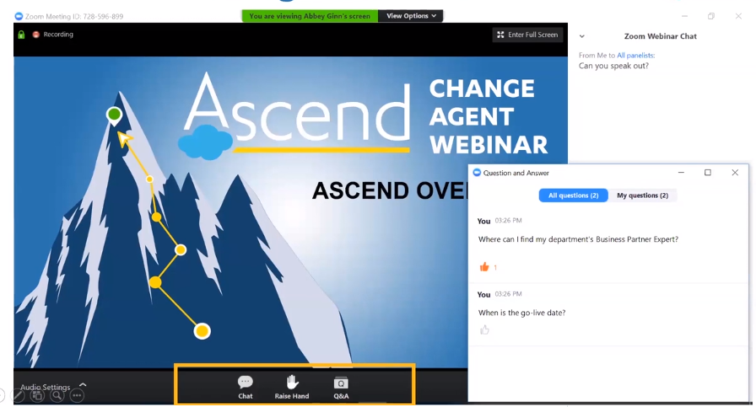
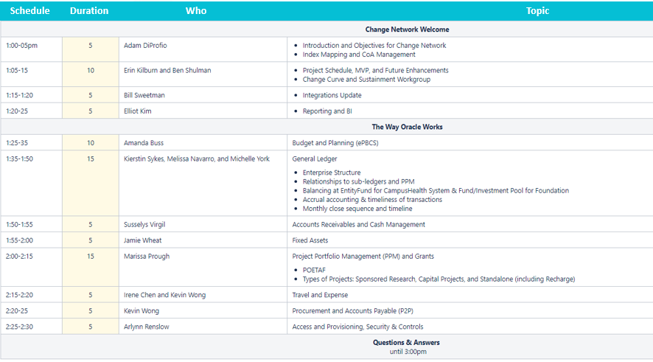
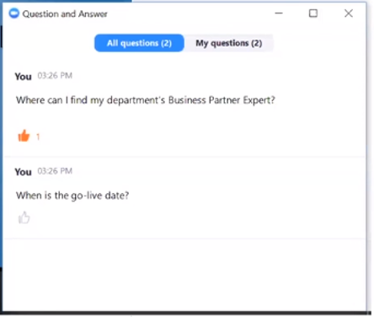
Using Zoom Webinar
Notes:
Participants should submit all questions through the Q&A feature. We will not review chats or raised hands during the presentation. We will have a half hour after the presentation to answer in-person audience questions and review the Q’s in the Q&A feature.

Slide 3
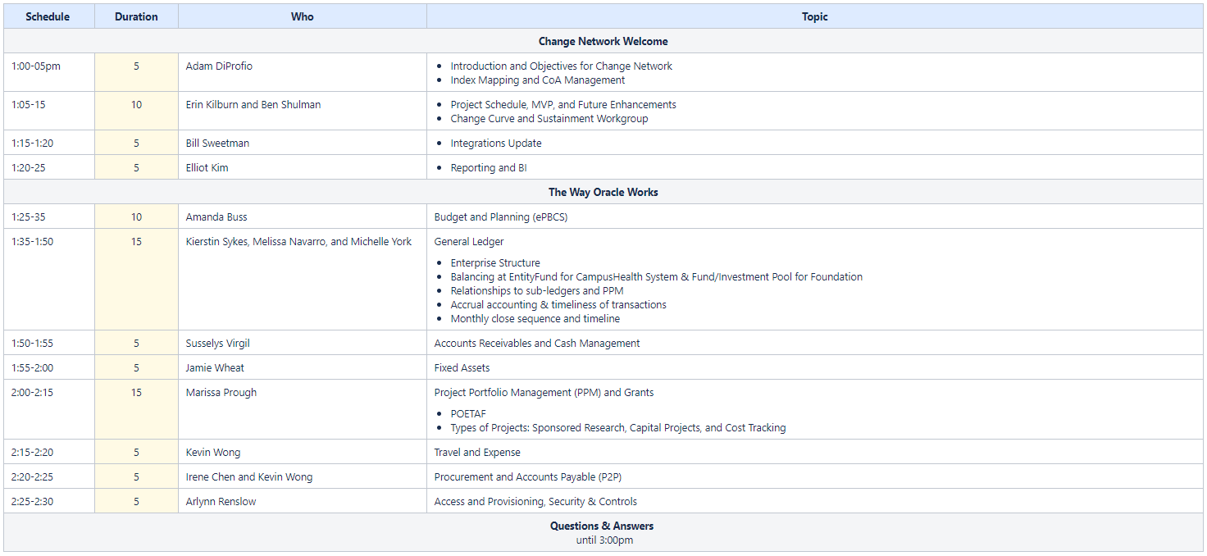
Agenda
Schedule
Duration
Who
Topic

Slide 4
Change Network Focus Areas
Phase 1: Index Categorization
Phase 2: Index Crosswalk
Phase 3: Legacy Chart Stabilization
Index Mapping
Test Case Creation
OCTOBER 2019
Training
Participation
Access
Role Mapping

Slide 5
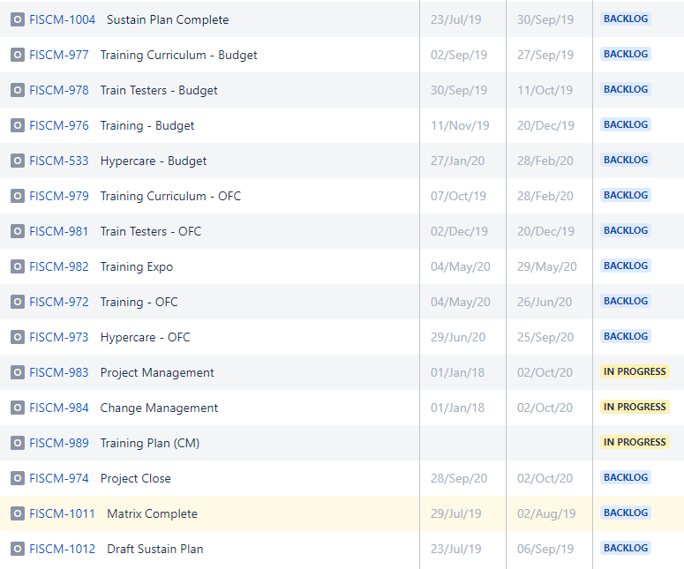
Change Management Milestones & Schedule
Milestone
Target Start
Target End
Task Status
Target End

Slide 6
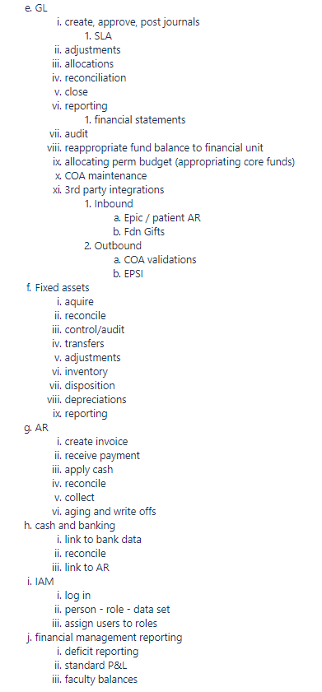
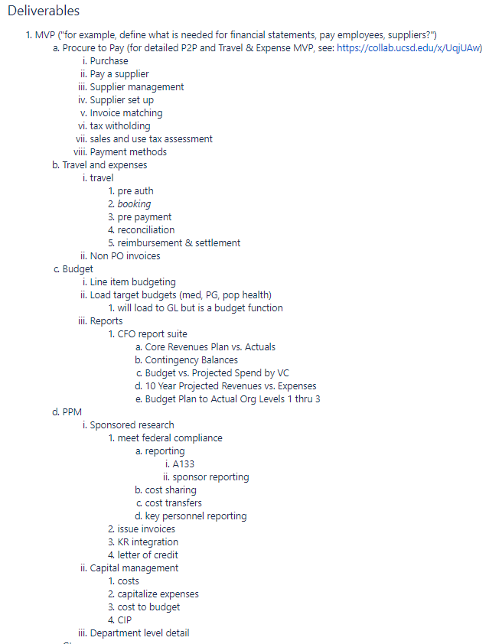

Minimally Viable Product (MVP)
Target End

Slide 7
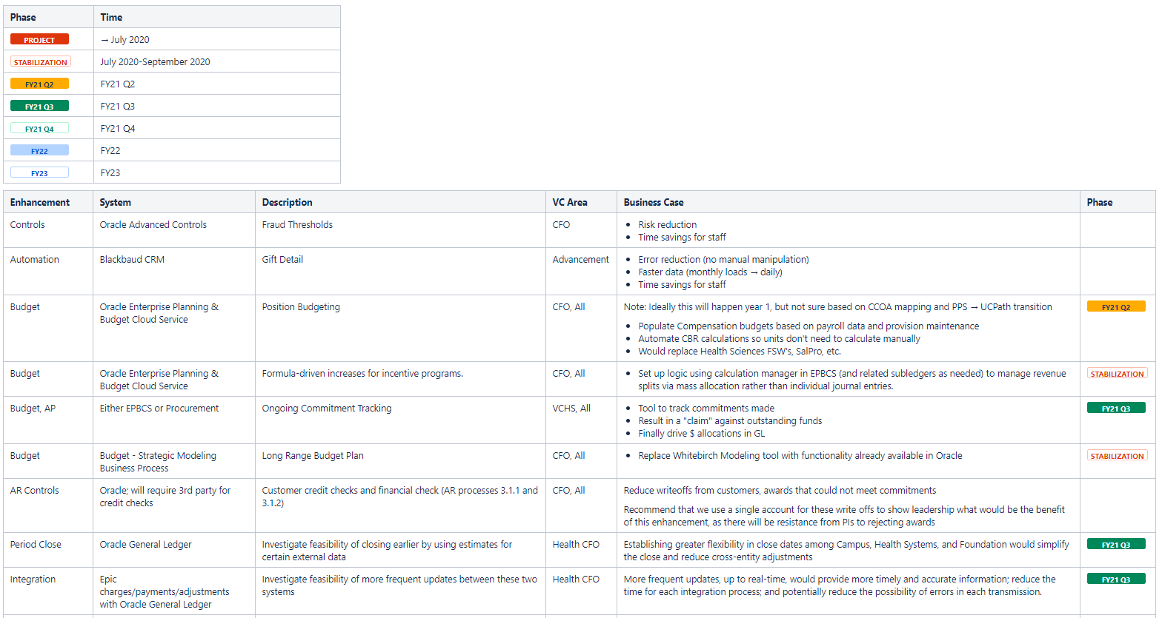
Future Enhancement Tracking
DRAFT- In Progress
Target End

Slide 8
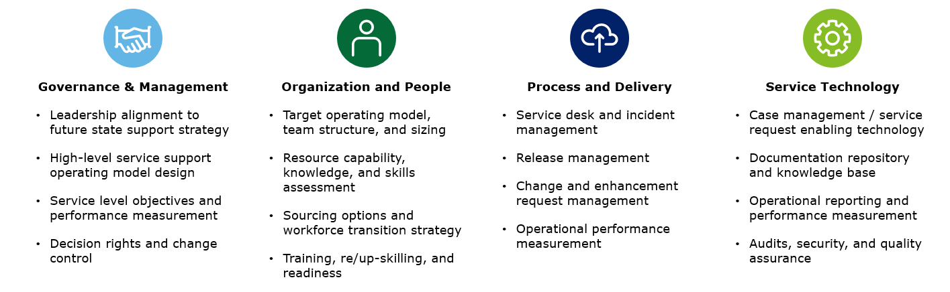
Financial Sustainment Workgroup
Target End
There are four primary focus areas that UC San Diego will need to analyze to determine the optimal sustainment model.

Slide 9
Integrations

Slide 10
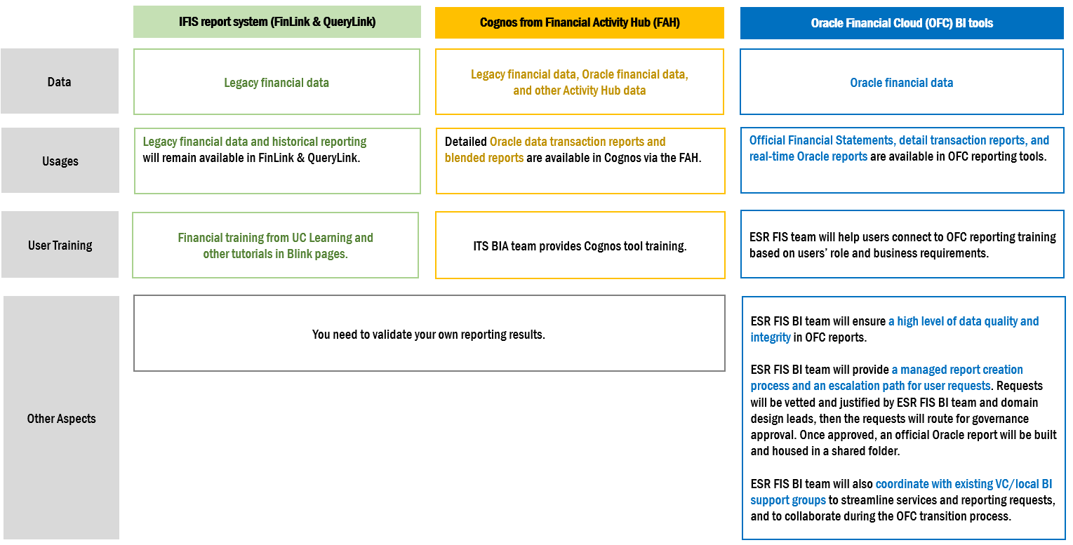
BI Tool User Guidelines

Slide 11
The Way Oracle Works
WOW!

Slide 12
Budgeting Tool
Enterprise Planning and Budgeting Cloud Service (EPBCS)

Slide 13


ERP and EPM: Complementary Perspectives
Enterprise Resource Planning (ERP):
Transaction Systems that drive efficiencies (automation of processes)
Enterprise Performance Management (EPM):
Drive effectiveness and accountability
ERP
EPM
General Ledger
AR/AP
Human Resources
Inventory
Fixed Assets
PPM
Supply Chain
Budgeting/Planning
Predictive Analysis/Forecasting
Scorecards/Dashboards
Financial Consolidation & Compliance
Long Range Modeling
Master Data Management
Interactive Reporting
Notes:
In current state (IFIS), budget transfers populate fund balance.
In future state, target budgets by line item will be developed in EPBCS and resulting funding allocations from central campus will be moved using GL transfers

Slide 14
The Big Shift(s)
IFIS -> Oracle
Budget Balance = Fund Balance
= PY Carryforward + Budget + Revenues – Expenses + Net Transfers
Transfer of Funds concept: simultaneously moving budget & fund balance
Budgets are constantly adjusted throughout the year
“Target” budgets will be developed in EPBCS
Resulting allocations from central campus will be moved using GL transfers
Budget will lock, yet funding can be transferred throughout the year
Carryforward Balances will roll forward as actuals on the Balance Sheet

Slide 15
Future State: Budget to Actuals Variance

Slide 16
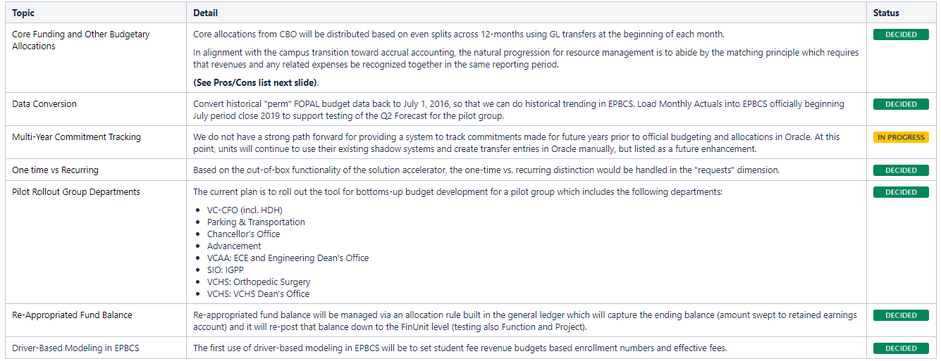
Design Decisions (Budget)

Slide 17
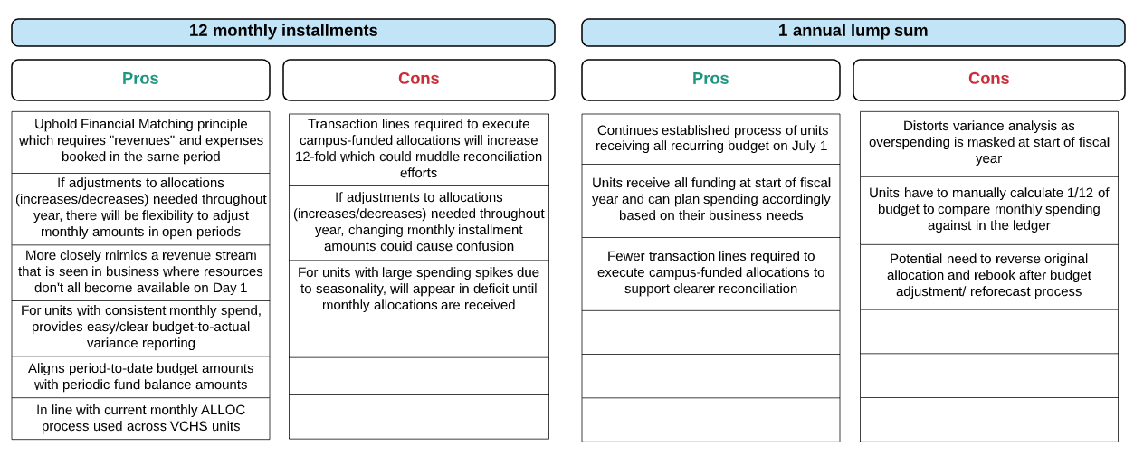
Decision Support:

Slide 18
General Ledger
Oracle Financials Cloud (OFC)

Slide 19
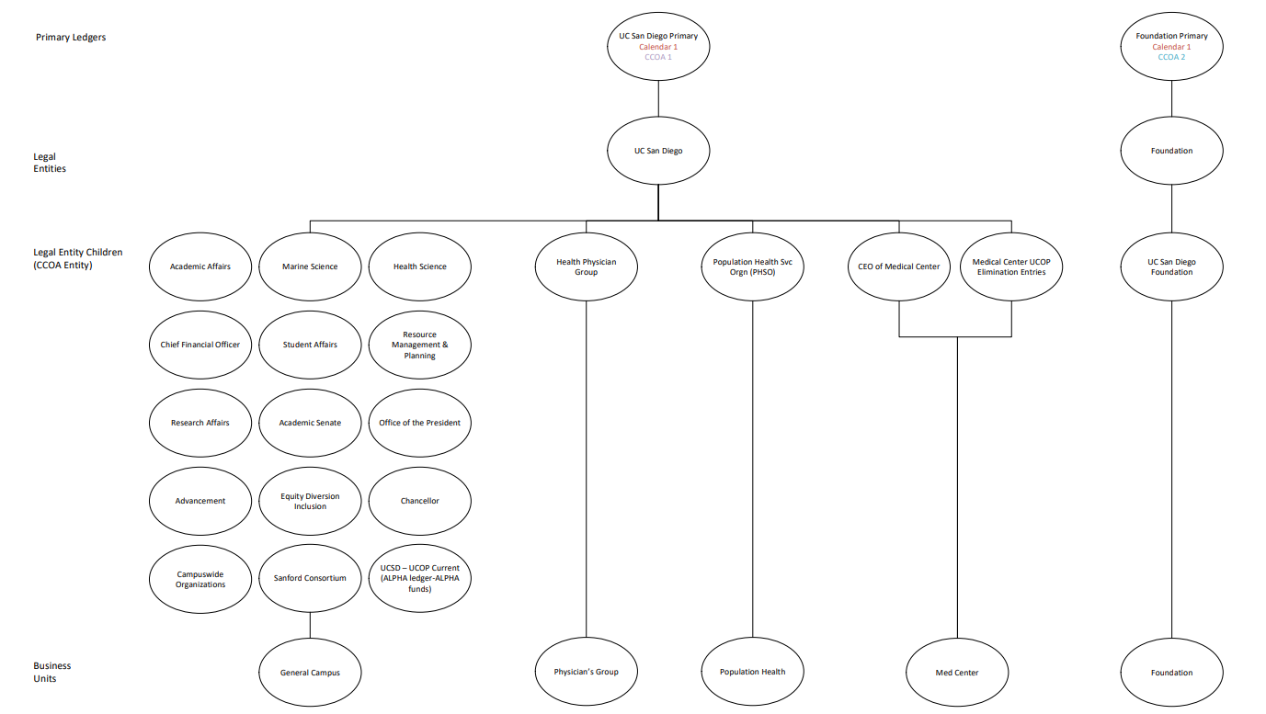
Enterprise Structure

Slide 20
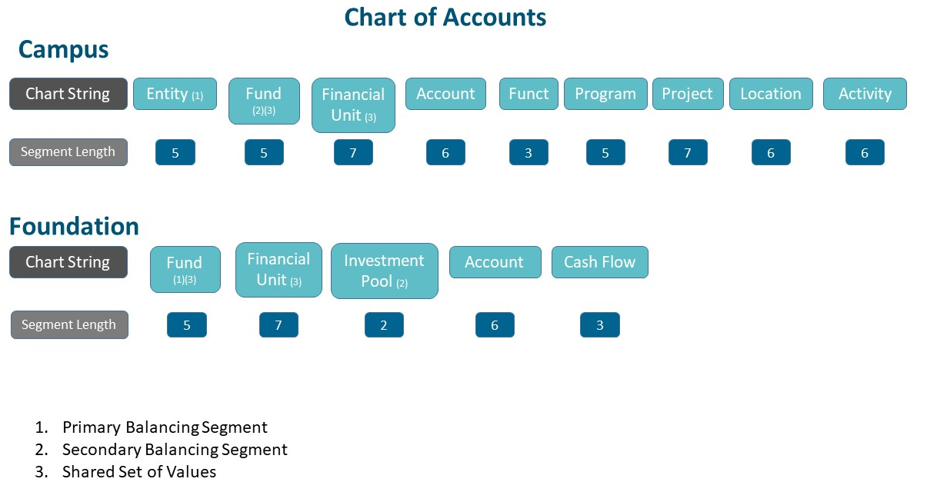
Balancing Segments

Slide 21
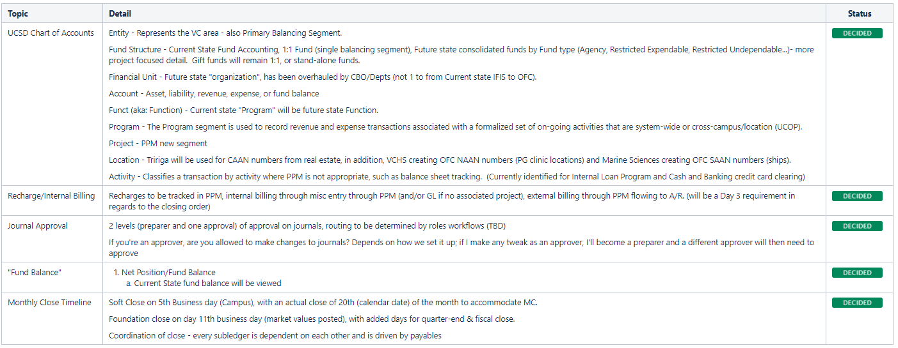
Design Decisions (GL)

Slide 22
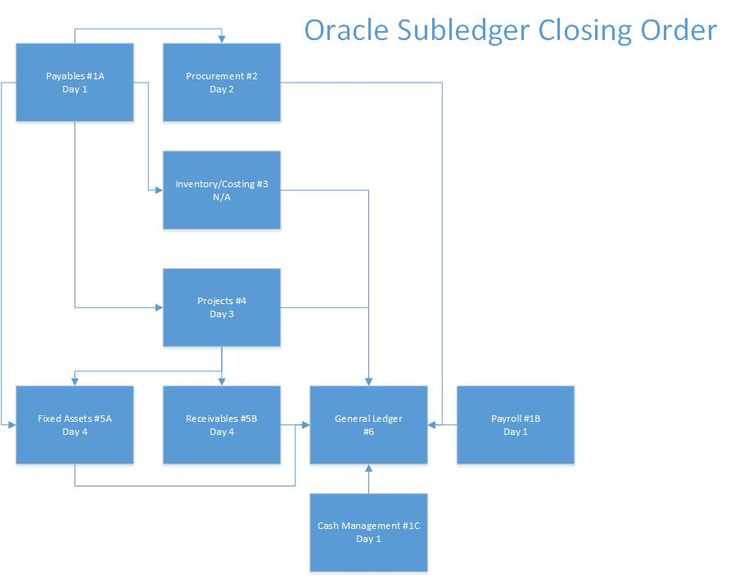
Monthly Close Timeline

Slide 23
Accounts Receivables and
Cash Management
Oracle Financials Cloud (OFC)

Slide 24
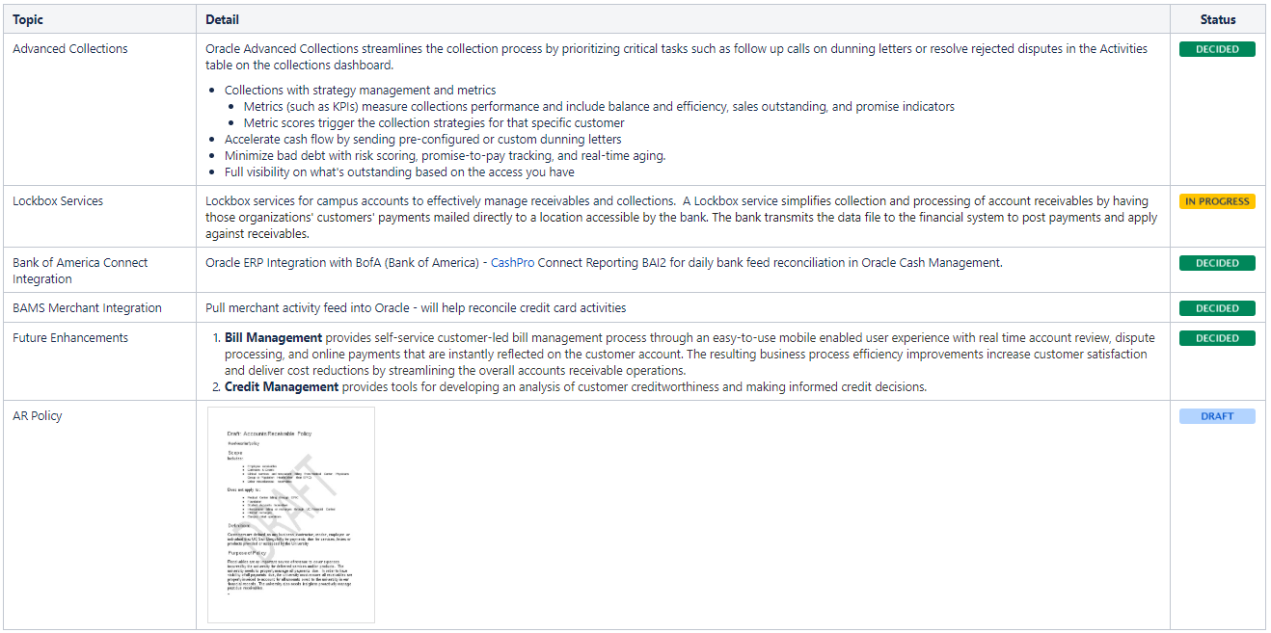
Design Decisions (ARCB)

Slide 25
Fixed Assets
Oracle Financials Cloud (OFC)

Slide 26
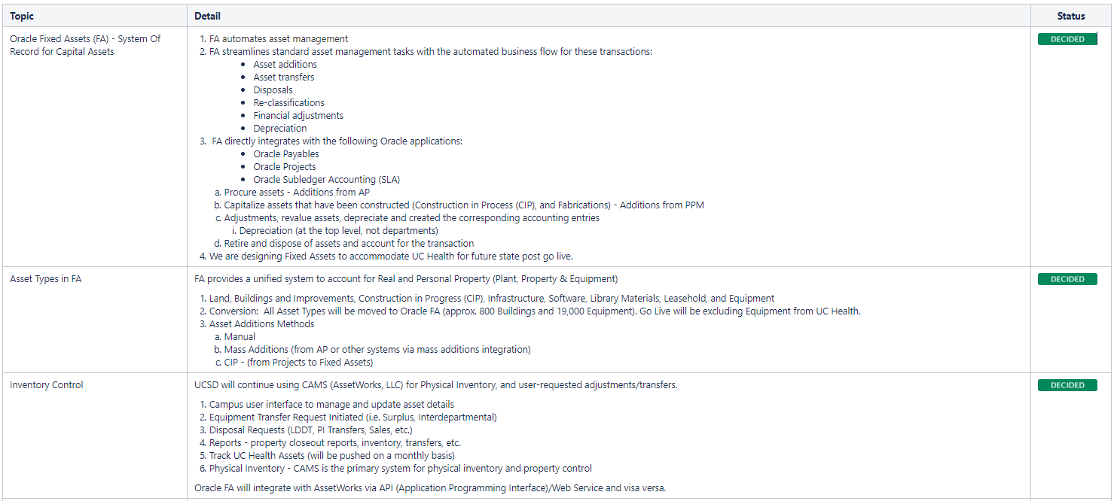
Design Decisions (FA)

Slide 27
Project Portfolio Management (PPM) and Grants
Oracle Financials Cloud (OFC)

Slide 28

What is a Project?
A project is used as a collection of financial activities. A project in Oracle is similar to the fund sources/indexes that are used today.
When Oracle Cloud goes live in July 2020, projects will be created for active fund sources/indexes that can be classified into project buckets like:
Lines of Service
Sponsored Research
Capital Projects
Cost Tracking
Events

Slide 29
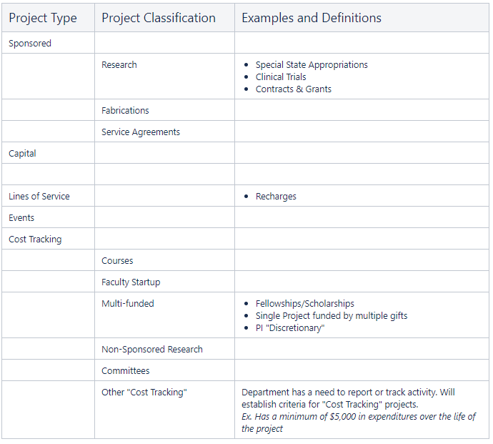
Examples of UC San Diego Project Types
Project Type Project Classification Examples and Definitions

Slide 30
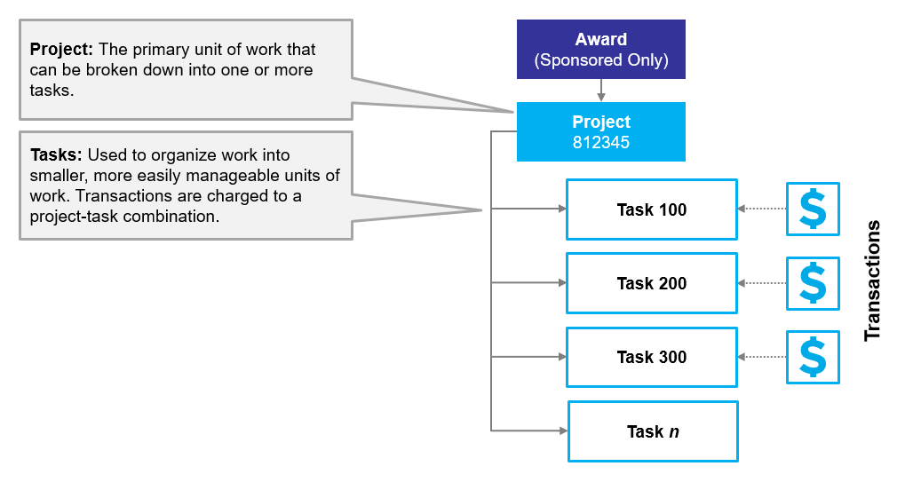
How are Projects Structured?
Oracle uses project and task structures to organize work performed and costs incurred.
EXAMPLE

Slide 31
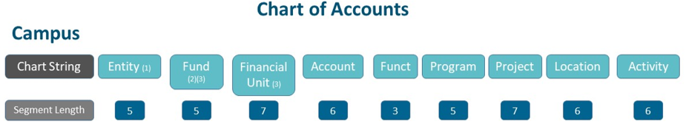
COA + POET(AF)
POET for all transactions in PPM
AF for PPM projects with Awards (Sponsored Projects)
+
P
O
E
T
A
F
Project Number
Expenditure Organization
Expenditure Types
Task Number
Award Number
Funding Sources
Auto generated
in Oracle
Department/FinU
Created in Oracle
via system setup (administrator)
User created
First 6 characters = Kuali Base award number; 7th is alpha (A/B/C/etc.)
REMS (UCOP) and then entered as Customer in Oracle
Non-REMS; directly in Oracle as customer

Slide 32
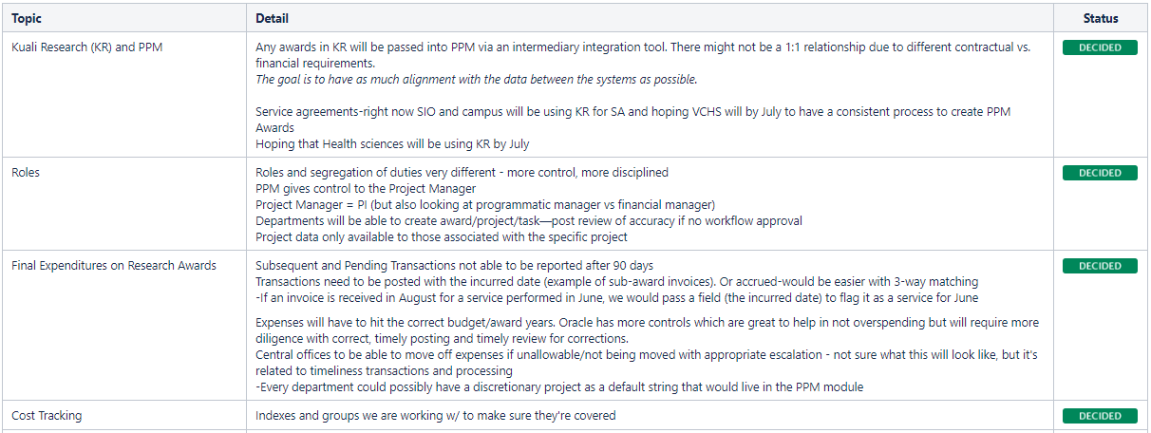
Design Decisions (PPM)

Slide 33
Travel and Expense
Oracle Financials Cloud (OFC) and Concur

Slide 34
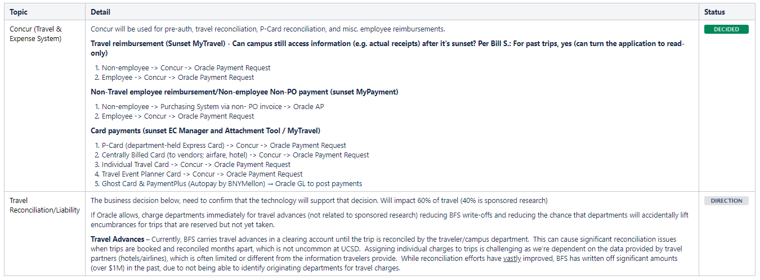
Design Decisions (T&E)

Slide 35
Procurement and Accounts Payable
Oracle Financials Cloud (OFC) and/or Jaggaer

Slide 36
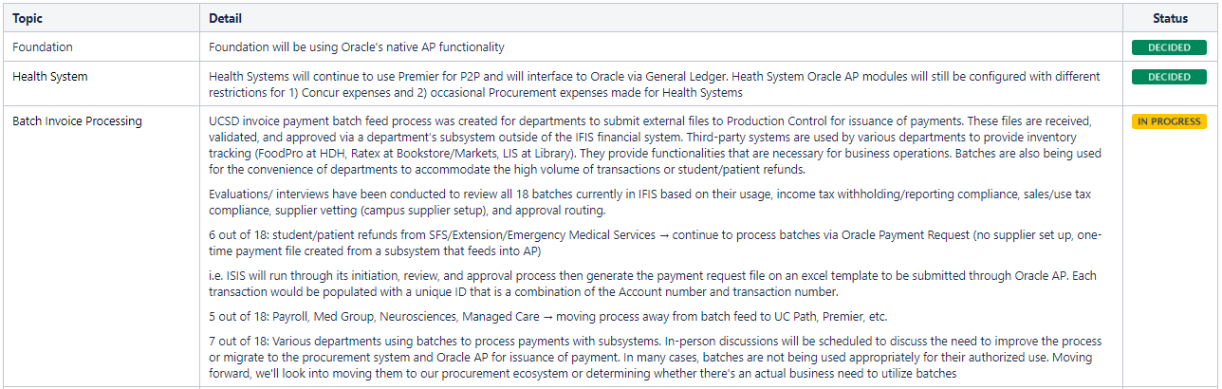
Design Decisions (P2P)

Slide 37
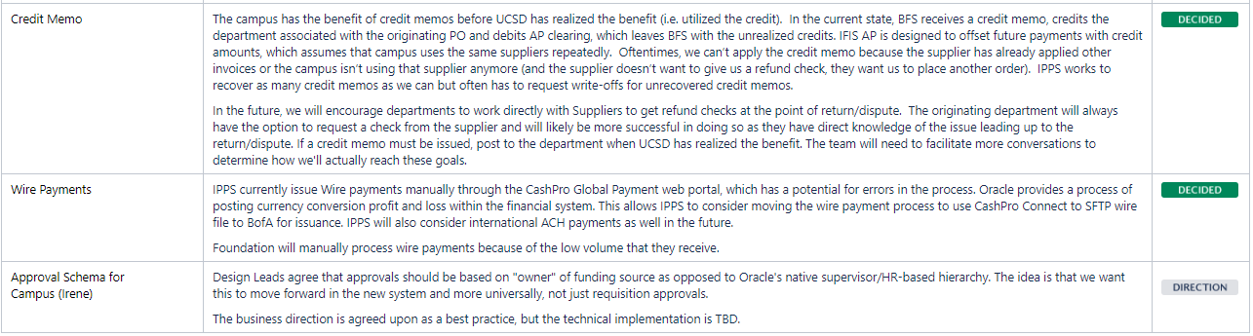
Design Decisions (P2P)

Slide 38
Access and Provisioning,
Security and Controls
Oracle Financials Cloud (OFC)

Slide 39
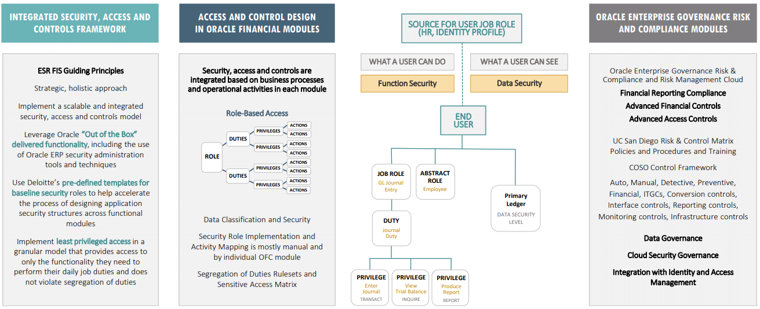
Security, Access & Controls Design Strategy

Slide 40

Question & Answers
Email
esrfisp@ucsd.edu
Recording and Deck on fis webpages by Friday, 8/23/19
Notes:
Kevin

